Slide 1
Principles of OOSD
Helpful Guidelines for Good Class Design, and the Source of Many Job Interview Questions
IN710 OOSD 2017
Session 2.1a
Notes:
Today’s talking is in two parts – a little bit of theory, then a little bit of syntax.
Then, a nice practical task.

Slide 2
Required Reading
Martin, Robert C. Clean Code. Prentice-Hall 2008.
Chapter 2: Meaningful Names
In the Safari Collection:
//proquest.safaribooksonline.com
In the Robertson: 005.1 CLE
Notes:
Note that all reading is examinable and important and you should come to class prepared to discuss assigned readings in an informed and thoughtful manner.
There will be more required chapters of Clean Code. If you want to be a better programmer, you should read the whole book.

Slide 3
Goal
To produce software that has high cohesion within modules and low coupling between modules.
High Cohesion: All behaviours of a single module are closely related.
Low Coupling: Behaviours of separate modules are not intertwined.
When cohesion is high and coupling is low, software will respond gracefully to change.
Notes:
We will see many example of this as we proceed, but we must start now to think of why this is true.
Why might high cohesion and low coupling make software easier to change?
Think about the version of Bridge Dealer that had “printHand”. It was the easiest to change.
Simplest examples:
Cohesion: You are asked to modify a particular bit of functionality in some legacy code. Do you know where to find it? If cohesion is high, behaviours that belong together will be grouped together (in a single class, for example), not spread about all over the place. So things will be easier to find.
Coupling: You are asked to modify a method of a class, and you do – perhaps changing a collection data structure from an array to a List. But it turns out a whole bunch of other methods actually have been accessing this guy’s array directly. Now that it’s a list, all those array operations start breaking. Here, the consuming methods knew about/was dependent on the inner details of the method you modified (specifically, they knew it stored its data in an array). This is coupling. In a coupled system, change at one location can ripple outward breaking methods way over on the other side of the architecture.
How does one achieve cohesive, uncoupled software? You can just be super vigilant as you design your architectures and hope you get everything right. This is a start. And you will, in time, learn to recognise some common traps.
But it is more efficient to learn some specific principles of class design which, when followed, tend to produce cohesive & uncoupled code.
In OO, there have developed a small set of such principles, which have been demonstrated, through some decades of experience, to be worth keeping in mind when you are designing classes. They are called SOLID….

Slide 4
The SOLID Principles
Single Responsibility Principle
Open/Closed Principle
Liskov Substitution principle
Interface Segregation Principle
Dependency Inversion Principle
These have developed from work originally done by Robert Martin.
butunclebob.com/ArticleS.UncleBob.PrinciplesOfOod
Notes:
These are general guidelines that you want to always have in the back of your mind as you design your software.
For the obvious reason, they are called SOLID. As in “we write SOLID code”
Keep in mind during these discussions that these are general goals. They are not always cut-and-dried; they are rarely 100% achievable.
But active awareness of these issues will help you to avoid common design errors.
Today we are going to talk about the first two, which are, conveniently, the most important. The other three we will touch on later in the semester. You are also free to read about them on your own, if you are interested.

Slide 5
Single Responsibility Principle - 1
“A class should have a single responsibility”
Code structure will be cleaner
Code will be more readable
Code is easier to test
Classes will be easier to modify
Classes will better suited to reuse
Notes:
Quotes from Martin
You can also think of ‘responsibility’ here as ‘purpose’ or ‘job to do’, but it’s called SRP
This is basically just another statement about modularity.
Find the logical units and encapsulate them
Don’t make classes that do some of this and some of that
(Although you also don’t want to go to far toward the other extreme and make a million itsy bitsy classes that each do one piece of the logical whole.)
You'll get greater re-use of the component since the component wasn't bundled with several other responsibilities the upstream consumer doesn't want or need;
But, we are also thinking about real code lifecycles, and the fact that changing requirements must be coped with
The SRP has a role here as well..

Slide 6
Single Responsibility Principle - 2
“A class should have a single reason to change.”
The only time you need to modify a class’s code is when its “one thing” changes
Notes:
An alternative conceptualisation of the SRP: A class should have a single reason to change
If you read Martin’s original discussion, you will see that is what he’s really talking about.
There should, for each class, be only one functional area where a change to spec requires a modification of the code.
And also, the inverse:
Classes should be built so that, if something in the spec changes, there is only one place in the code that needs to be touched.
For example, a class should either talk to the database, or format output for the UI, not both. Classes that deal with the database won’t need to be updated if the UI changes, and vice versa.
When requirements change, modification is kept to just those spots directly affected, and these changes don’t have unanticipated consequences elsewhere in classes that whose responsibilities have leaked over into ours (assuming out classes are not coupled).

Slide 7
Single Responsibility Principle
"Programs should be structured in in such a way that we can make changes easily. When we make a change we want to be able to jump to a single clear point in the system and make the change.”
Martin Fowler
And we don’t want a ripple effect from that change
Notes:
And we don’t want a ripple effect of changes to other classes whose purpose has leaked over into other classes
To know if you’re following the SRP, it is sometimes suggested that you try to explain (in words) what you class’s purpose is. If the explanation is longer than one sentence, or if it has a lot of ‘ands’ in it, you might want to consider breaking it up into more encapsulated classes.
Note that a top-level driver sort of class may often do a lot of things BY CALLING OTHERS CLASSES, but its purpose is still delineated (“run simulation”)

Slide 8
SRP - Example
Automobile
Start()
Stop()
ChangeTires()
Drive()
CheckOil()
GetOil()
Notes:
Imagine you are modelling a car for some reason (perhaps you are writing a carbon footprint simulator)
And you start with this class.
Now assume that you swap in a new physics engine. You will probably have to modify the start, stop and drive methods to use the new physics API.
Now imagine that you are changing from imperial to metric tire pressure units, or whatever one measures oil pressure in. You will probably have to modify ChangeTires and/or CheckOil.
This is a sign that your class violates the SRP – two different logical changes that both required you to modify this class.
Note that this can cause problems from *both* directions:
The more reasons to touch existing code, the more chance to break it
You know you have to change tire pressure units, how can you be sure that you have updated all the classes affected by that change?
With some thought, you can see that this class actually is doing two things (i.e. has two responsibilities): being a car and handling car maintenance.
An solution is to *encapsulate* the maintenance activities into their own class, like this..

Slide 9
SRP - Example
Automobile
Start()
Stop()
Drive()
GetOil()
Mechanic
ChangeTires(Automobile)
CheckOil(Automobile)
Notes:
Depending on how your application works, you could possibly give your Automobile class a Mechanic instance to work with.
Does the Automobile class now follow SRP?
One might argue not. If its one responsibility is “be a car”, then it really shouldn’t be responsible for the Drive method, which probably has different dependencies than do the start, stop and getOil methods.
So, you might argue for a Drive class.
As mentioned above, when applying the SRP you must keep an eye on your “granularity”. Very strict application would require one class for every method.
Among the SOLID principles, SRP is the one that really requires the most judgement, because the impact of change can be difficult to predict and very situation dependent.
So treat it as an important but flexible guideline: Don’t just dump everything into a single monolithic class. Encapsulate, abstract and isolate in sensible ways.
Be assured that with experience (especially the experience of having to deal with badly designed architectures) you will get increasingly good at recognising violations of cohesion caused by breaking the SRP.

Slide 10
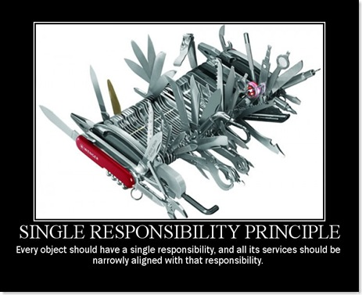
SRP
Notes:
There are these sort of famous joke posters for each of the SOLID principles. Don’t know how useful they are for teaching you how to apply the principles to your own code, but they’re cute.

Slide 11
Open/Closed Principle
“Software entities (classes, modules, functions, etc.) should be open for extension, but closed for modification.”
Construct your classes so that requirements changes can be managed by adding code, not by modifying existing code
Notes:
Adding = extension; modifying = modification
Bottom line: Once you have written code that works, you should ideally never touch it again, because if you don’t touch it, you can’t break it.
If you’re writing nice modular code, you probably have objects being used by other objects all over the place (code reuse = good). If you now break that class, you break everybody who is using it (==bad).

Slide 12
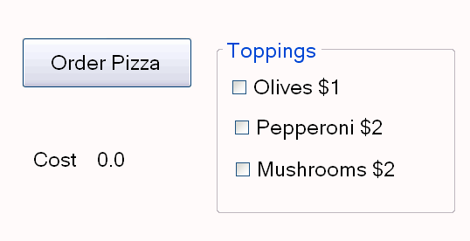
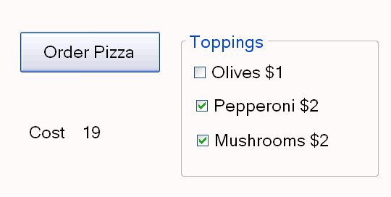
Open/Closed Principle
Notes:
This is a very simple little pizza ordering app.
There is a Pizza class with an addTopping method and a computeCost method
In this example, we’re interested in the Pizza class itself
The button code adds the indicated toppings and displays the result of the computeCost method
Let’s look….

Slide 13
Open/Closed Principle
private void button1_Click(object sender, EventArgs e)
{
Pizza currPizza = new Pizza();
if (ckOlives.Checked)
currPizza.addTopping(ETopping.Olives);
if (ckPepperoni.Checked)
currPizza.addTopping(ETopping.Pepperoni);
if (ckMushrooms.Checked)
currPizza.addTopping(ETopping.Mushrooms);
int pizzaCost = currPizza.computeCost();
lblCost.Text = pizzaCost.ToString();
}
Notes:
Here is the button code
Again, we’re not interested in the interface code, so this is just to show you how Pizza is used
So all very straightforward.
Now, let’s look at Pizza

Slide 14
Open/Closed Principle
enum ETopping { Olives, Pepperoni, Mushrooms }
class Pizza
{
ETopping[] toppingArray;
int nToppings;
public Pizza()
{
toppingArray = new ETopping[10];
nToppings = 0;
}
public void addTopping(ETopping newTopping)
{
toppingArray[nToppings] = newTopping;
nToppings++;
}
Notes:
So it’s got a nice enum type and a nice array of toppings and an addTopping method and all is good

Slide 15
Open/Closed Principle
public int computeCost()
{
int totalCost = 15;
for (int i = 0; i < nToppings; i++)
{
switch (toppingArray[i])
{
case ETopping.Olives:
totalCost += 1;
break;
case ETopping.Pepperoni:
totalCost += 2;
break;
case ETopping.Mushrooms:
totalCost += 2;
break;
}
}
return totalCost;
}
}
Notes:
Here is computeCost
This works great…..
…until I want to add anchovies…..
That is, I want to modify the toppings enum.
But...
I can’t add anchovies to the enum without modifying existing code in the Pizza class.
The requirements for one entity (the toppings) have changed.
But that change has affected another entity (the Pizza class), and required me to change its code.
This gives me a chance to break the Pizza class.
And it could be worse, of course. If there are other places in the class where we have used the same approach (printing out an invoice, sending instructions to the pizza oven, drawing an picture of the pizza) their code will also have to be changed.
This is a violation of Open/Closed. In this architecture, to make the required change, we can’t just add, we must also modify.
It is also a violation of the SRP. It should not be the job (responsibility) of the Pizza to keep track of the cost of individual toppings.
In a more general sense, this is what coupling does.
These classes are coupled because Pizza knows the details of the enums, specifically, how much each one costs.
How would you have written that architecture so that you could incorporate the change in requirements (adding anchovies) by adding code, rather than changing existing code? (Answer=> Don’t use an enum. Use a topping class, who knows its cost and type. Or, if you’re really feeling elaborate, a base topping class and descendents)

Slide 16
Liskov Substitution Principle
Subclasses should be substitutable for their base class.
All members of an inheritance hierarchy should fulfill the same behavioural contract.
If they don’t then your “is-a” abstraction is probably wrong.
Notes:
Just briefly. We will discuss this one later, when we look at more complex inheritance architectures…
The LSP helps us to avoid misusing inheritance, and consequently running into the problems that result when this occurs.
A user of a base class should continue to function properly if any derivative of the base class is passed to it.
Because children in a true is-a hierarchy only extend the parent, they don’t modify it.
Do you see the LSP is actually an extension of OCP? A child class should be an extension of, not a modification of, the parent. If this is true, then the child can do everything the parent can do (because it has not modified the parent’s behaviour), and you should always be able to swap in a child for a parent.
Failure to follow the LSP almost always leads to problems with the OCP, as you wiggle around coding in special cases to your class family

Slide 17
Interface Segregation Principle
“The dependency of one class to another one should depend on the smallest possible interface.”
“Clients should not be forced to depend on methods they do not use.”
Notes:
Again briefly…
We will talk about this some more when we meet the syntactic structure “interface”, next week, where it applies most directly
But this one is very closely related to the SRP: don’t stuff everything into one big garbage multipurpose class

Slide 18
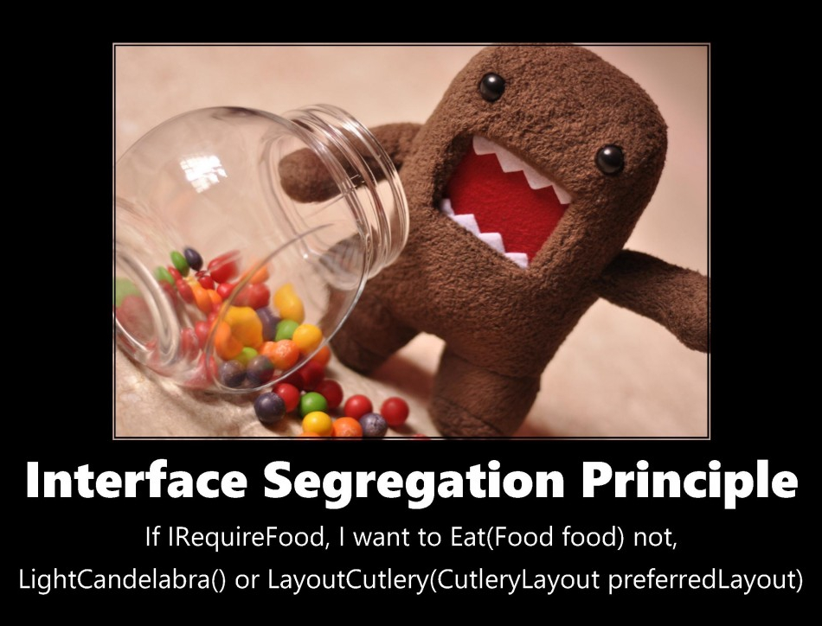
Interface Segregation Principle

Slide 19
Dependency Inversion Principle
“Program to the most abstract class possible”
Corollary: High-level modules should not depend on (concrete) low-level modules
Example: Assume a high-level game controller class, and a hierarchy of game characters.
void doSomething(Vampire V)
void doSomething(Enemy E)
void doSomething(GameCharacter G)
Notes:
Note that we often write code where high-level classes depend on low-level ones – like Maze depending on Cell, and LinkedList depending on Node. We need to do this carefully.
doSomething is a method of the Game Controller.
These methods are in increasing order of goodness
The more high level your code, the more flexible your code is
With the first method, if you make a local change to the Vampire class, you may break the GameController class. This is bad.
Think about the problems we ran into implementing the Linked Lists, when we wanted different data. This was exactly because we violated the Dependency Inversion Principle

Slide 20
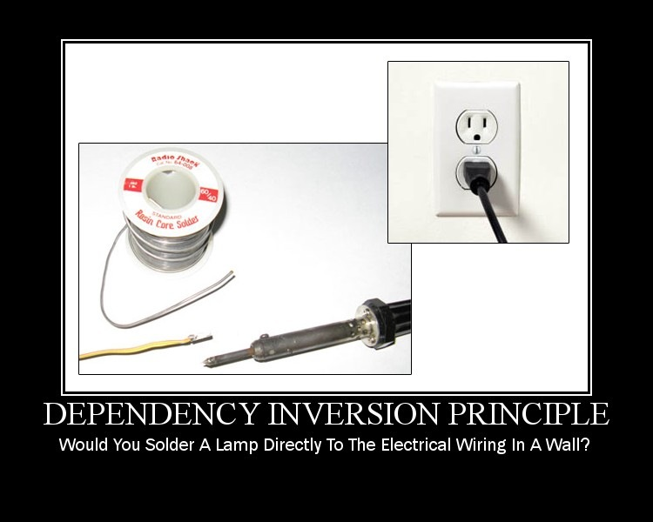
Dependency Inversion Principle
Notes:
The plug is an abstract interface.
It makes the lamp reusable (movable).
Rather than working with classes that are “hard-wired” to each other, you want to work with a standard interface that allows you to swap out the elements on each end of the communication.
The code at each end should only know about the interface, not about how classes implement that interface.

Slide 21
Dependency Inversion != Dependency Injection
Notes:
Dependency injection refers to passing in dependent objects rather than hard-coding in dependent objects.
Class A that needs an element of the Class B family. If you hard-code it in as a data property, say, you can only ever use one kind of class B. If you pass it in in the constructor or other method, you can supply any Class B instance.
When we get to interfaces, we will see that this “passing in” becomes even more flexible.

Slide 22
Consequences of Ignoring the Core OO Principles
The system is
Rigid
Changing one part of the code causes or requires change to many other parts of the code.
Fragile
Changes in one part of the code break other parts of the code
Immobile
The components/parts of the code cannot be easily reused, because they are tangled.
Notes:
(cf. Martin)
These are bad.
As we work through some moderately sized systems this term, keep these principles in mind as much as possible
Watch out for your own violations, and observe the consequences.
We will also probably look at some intentionally horrible code examples, just for practice.

